Slide 1

Fire Awareness Training

Slide 2
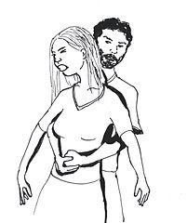
Key points we covered at the fire awareness training are:
How to give first aid : first asking the person if he is feeling okay. Then check if he is breathing. Next give the first aid based on the case.
How to help if the person is choking. It depends based on the persons case. That means we gave them different aid if the person is pregnant or child.

Slide 3
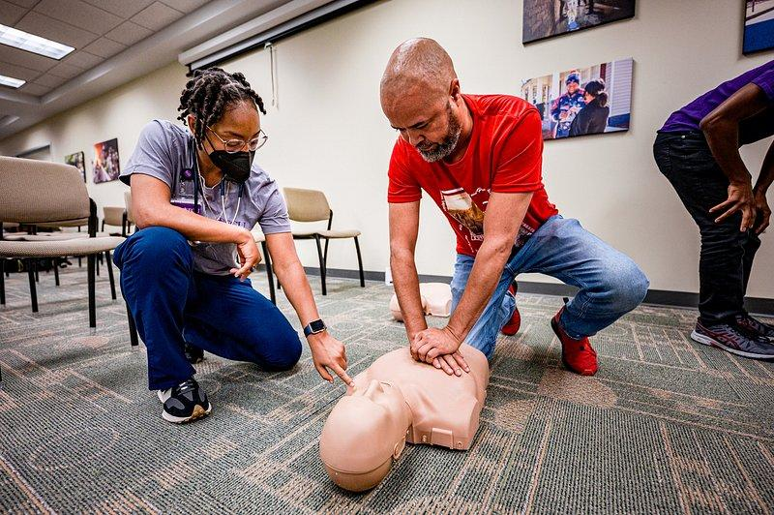
How to do CPR: we need to the CPR until the person wakes up.
How to help something in fire; a house, a car and anything else

Slide 4
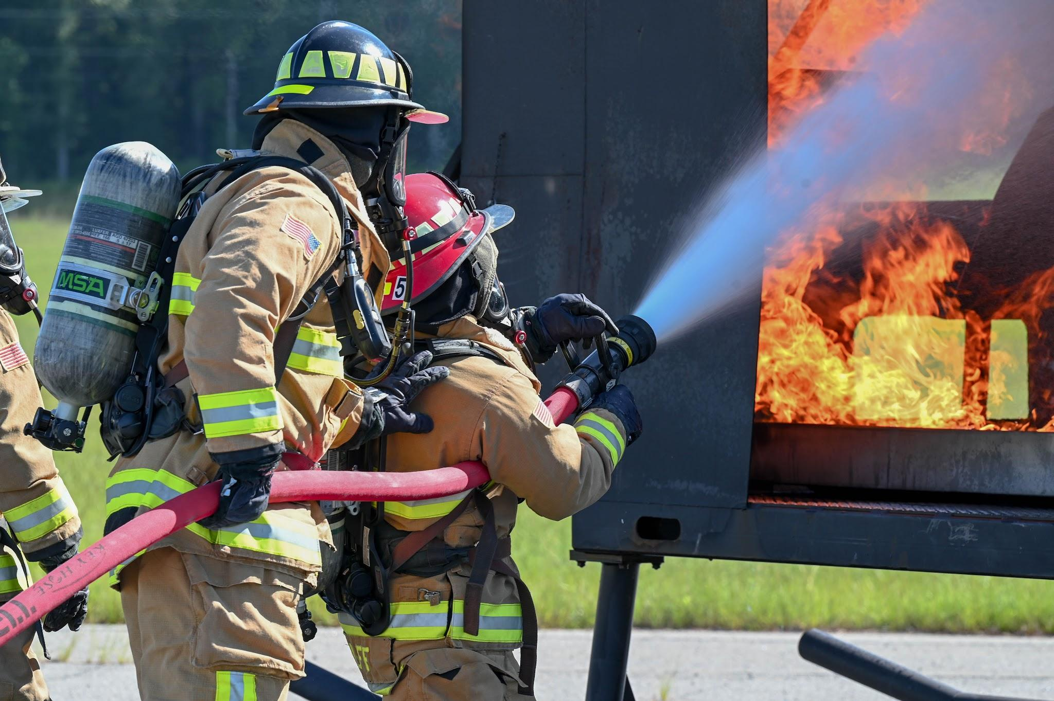
How to help something in fire; a house, a car and anything else: we use fire extinguishing for the fire.

Slide 5
When we need to give the first aid we must hurry in order to save the person.

